Slide 1
FUNCTIONS OF MANAGEMENT
Session 5

Slide 2
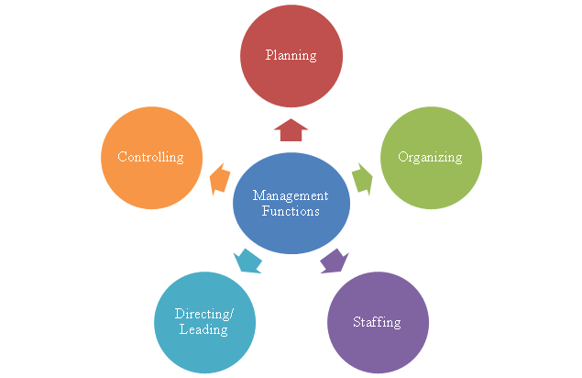

Slide 3
Planning
“Planning is deciding in advance - what to do, when to do & how to do. It bridges the gap from where we are & where we want to be”.
A plan is a future course of actions.
Planning is determination of courses of action to achieve desired goals. Thus, planning is a systematic thinking about ways & means for accomplishment of pre-determined goals.
Planning is necessary to ensure proper utilization of human & non-human resources.
It is an intellectual activity and it also helps in avoiding confusion, uncertainties, risks, wastages etc.

Slide 4
Organizing
To organize a business is to provide it with everything useful or its functioning i.e. raw material, tools, capital and personnel’s”
It is the process of bringing together physical, financial and human resources and developing productive relationship amongst them for achievement of organizational goals.

Slide 5
Organizing as a process involves:
Identification of activities.
Classification/grouping of activities.
Assignment of duties.
Delegation of authority and creation of responsibility.
Coordinating authority and responsibility relationships.

Slide 6
Staffing
“Managerial function of staffing involves manning the organization structure through proper and effective selection, appraisal & development of personnel to fill the roles designed in the structure”

Slide 7
Staffing involves:
Manpower Planning (estimating man power in terms of searching, choose the person and giving the right place).
Recruitment, Selection & Placement.
Training & Development.
Remuneration.
Performance Appraisal.
Promotions & Transfer.

Slide 8
Directing
Direction is that inter-personnel aspect of management which deals directly with influencing, guiding, supervising, motivating sub-ordinate for the achievement of organizational goals.

Slide 9
Elements of Direction
Supervision- implies overseeing the work of subordinates by their superiors. It is the act of watching & directing work & workers.
Motivation- means inspiring, stimulating or encouraging the sub-ordinates with zeal to work. Positive, negative, monetary, non-monetary incentives may be used for this purpose.
Leadership- may be defined as a process by which manager guides and influences the work of subordinates in desired direction.
Communications- is the process of passing information, experience, opinion etc from one person to another. It is a bridge of understanding.

Slide 10
Controlling
“Controlling is the measurement & correction of performance activities of subordinates in order to make sure that the enterprise objectives and plans desired to obtain them as being accomplished”
Controlling has following steps:
Establishment of standard performance.
Measurement of actual performance.
Comparison of actual performance with the standards and finding out deviation if any.
Corrective action.

Slide 11


